Slide 1



Custom Networking
(Part 1)
Networking Basics
Working with URL
Reference: tutorial-2015/networking/index.html

Slide 2
Contents
Networking Basics
URL and URLConnection classes
InetAddress class

Slide 3
1- Networking Basics
Networking Terminology
Client-Server Model

Slide 4
Terminologies - 1
Platform: hardware + operating system.
Client: an application running in a computer (such as browser) can receive data from another (server).
Server: an application running in a computer (such as IIS- Windows Internet Information Service) can supply data to others (clients).
IP address (internet protocol): unsigned integer helps identifying a network element(computer, router,…).
IPv4: 4-byte IP address, such as 192.143.5.1
IPv6: 16-byte IP address
Port: unsigned 2-byte integer helps operating system differentiating a network communicating process.
Protocol: Rules for packaging data of a network communication because client and server can be working in different platform. Two common basic protocols are TCP and UDP

Slide 5
Terminologies - 2
TCP: (Transmission Control Protocol) is a connection-based protocol (only one connecting line only) that provides a reliable flow of data between two computers based on the acknowledge mechanism.
UDP: (User Datagram Protocol) is a protocol that sends independent packets of data, called datagrams, from one computer to another with no guarantees about arrival (many connecting lines can be used, acknowledge mechanism is not used). Many firewalls and routers have been configured not to allow UDP packets. Ask your system administrator if UDP is permitted.
Serialization: a process that converts object’s state (values in fields of the object) to a byte stream.
De- serialization: a process that splits data in a byte stream then set data to fields of an object.

Slide 6
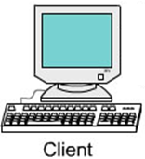
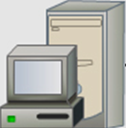
Client-Server Model
Step 2: Server analyzes the request then process it
Step 1: Client sends a request to server
Request can be
(file.html, file.txt
Script file -.asp, .aspx. .php, .jsp….
Execute a method of running object
Response:
File.html, .txt,…
Result of processing
Server
( can be a container, web container or Application container)
Client
(can be a browser)
Step 3: Server sends response to client

Slide 7
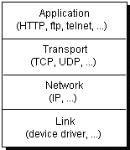
Client-Server Model: Anatomy - 1
Computers running on the Internet communicate to each other:
data
data
Port
H1
data
H1
data
IP
H2
H1
data
H2
H1
data
H3
H2
H1
data
Network
Environment
H3
H2
H1
data
A package is attached an appropriate header (H-identifiable data) when it is transferred to each layer. A layer is an applications or a function library of network managing system

Slide 8
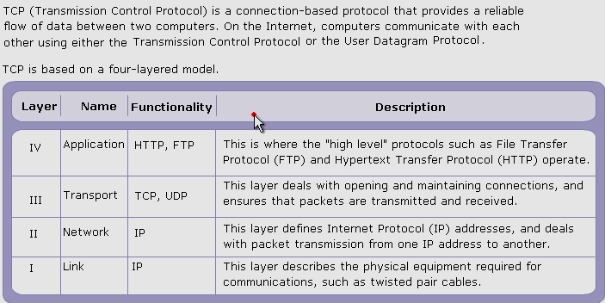
Client-Server Model: Anatomy - 2

Slide 9
IP addresses and hostnames
Internet protocol (IP) addresses
  Every host on Internet has a unique IP address, examples:
      143.89.40.46, 203.184.197.198
      203.184.197.196, 203.184.197.197, 127.0.0.
  More convenient to refer to using hostname string
      cse.ust.hk, tom.com, localhost
  One hostname can correspond to multiple internet addresses:
    www.yahoo.com:
      66.218.70.49; 66.218.70.50; 66.218.71.80; 66.218.71.84; …
  Domain Naming Service (DNS) maps names to numbers
IP address of localhost = 127.0.0.1

Slide 10
Ports
Ports
  Many different services can be running on the host
  A port identifies a service within a host
  Many standard port numbers are pre-assigned
    time of day 13, ftp 21, telnet 23, smtp 25, http 80
    see /etc/services on workstation for list of all assigned ports
  IP address + port number = "phone number“ for service

Slide 11
Protocols
protocols : rules that facilitate communications between machines
Examples:
  HTTP: HyperText Transfer Protocol
  FTP: File Transfer Protocol
  SMTP: Simple Message Transfer Protocol
  TCP: Transmission Control Protocol
  UDP: User Datagram Protocol, good for, e.g., video delivery)
Protocols are standardized and documented
    So machines can reliably work with one another

Slide 12
Client-Server Interaction - 1
Client-Server interaction
  Communication between hosts is two-way, but usually the two hosts take different roles
  Server waits for client to make request
    Server registered on a known port with the host ("public phone number")
    Usually running in endless loop
    Listens for incoming client connections

Slide 13
Client-Server Interaction - 2
Client "calls" server to start a conversation
  Client making calls uses hostname/IP address and port number
  Sends request and waits for response
Standard services always running
  ftp, http, smtp, etc. server running on host using expected port
Server offers shared resource (information,database, files, printer, compute power) to clients

Slide 14
URL and URN
How to specify a resource in internet/network?
URL: Uniform Resource Locator
URN: Uniform Resource Name. It involves URL and pathname
http://www.abc.com:80/users/index.html
Protocol
://
Host
:
Port
(option)
File
Object name
"rmi://localhost:1098/Math1";

Slide 15

How do TCP/IP protocols work?
IP picks up packets, and ensures that they reach the destination.
TCP tracks the
packets
Internet
TCP assembles packets after checking for errors, missed packets etc.
TCP breaks up data into packets

Slide 16
2- Working With URL
The package java.net
The class java.net.URL
Demonstrations for using the URL and URLConnection classes to get contents from urls.

Slide 17
The java.net package
It contains basic APIs for connecting computer networks.
Reference: docs-Java8/api/java/net/package-tree.html
Common used classes:
  java.net.URL (implements java.io.Serializable)
  java.net.URLConnection ( abstract class)
    java.net.HttpURLConnection
    java.net.JarURLConnection
  java.net.URLDecoder
  java.net.URLEncoder
  java.net.URLStreamHandler
  java.net.ServerSocket (implements java.io.Closeable)
  java.net.Socket (implements java.io.Closeable)
This session will introduce the URL only.

Slide 18
The URL Class
A URL takes the form of a string that describes how to find a resource on the Internet. URLs have two main components: the protocol needed to access the resource and the location of the resource.
public final class URL extends Object implements Serializable
Constructors:
  URL(String spec) Creates a URL object from the String representation.
  URL(String protocol, String host, int port, String file)Creates a URL object from the specified protocol, host, port number, and file.
  URL(String protocol, String host, int port, String file, URLStreamHandler handler)Creates a URL object from the specified protocol, host, port number, file, and handler.
  URL(String protocol, String host, String file)Creates a URL from the specified protocol name, host name, and file name.
  URL(URL context, String spec)Creates a URL by parsing the given spec within a specified context.
  URL(URL context, String spec, URLStreamHandler handler)Creates a URL by parsing the given spec with the specified handler within a specified context.

Slide 19
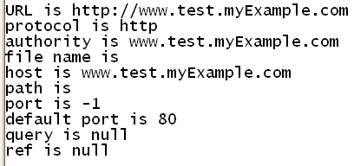
Demo 1: using the URL class
// This program will get components in a URL and no connection is carried out.
import java.net.*;
import java.io.*;
public class Main {
public static void main(String [] args) {
try {
URL url = new URL("http://www.test.myExample.com");
System.out.println("URL is " + url.toString());
System.out.println("protocol is " + url.getProtocol());
System.out.println("authority is " + url.getAuthority());
System.out.println("file name is " + url.getFile());
System.out.println("host is " + url.getHost());
System.out.println("path is " + url.getPath());
System.out.println("port is " + url.getPort());
System.out.println("default port is " + url.getDefaultPort());
System.out.println("query is " + url.getQuery());
System.out.println("ref is " + url.getRef());
} catch(IOException e) { e.printStackTrace(); }
}
}

Slide 20
Demo 2: using the URLConnection class
// This program needs connection. If not the java.net.UnknownHostException will be thrown
import java.net.*;
import java.io.*;
public class Main {
public static void main(String [] args) {
URL url;
URLConnection urlCon;
try {
url = new URL("http://www.fpt.vn");
urlCon = url.openConnection();
BufferedReader in = new BufferedReader(new
InputStreamReader(urlCon.getInputStream()));
String urlString = "";
String current;
while((current = in.readLine()) != null) {
urlString += current + "\r\n";
}
System.out.println(urlString);
}catch(IOException e) {e.printStackTrace(); }
}
}
When running this program, the content of the default web page of the website will be displayed

Slide 21
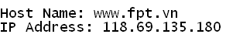
Demo 4: Using InetAddress class
Java InetAddress class represents an IP address. The java.net.InetAddress class provides methods to get the IP of any host name for example www.javatpoint.com, www.google.com, www.facebook.com etc.
import java.net.*;
import java.io.*;
public class Main
{public static void main(String [] args)
{try{
InetAddress ip=InetAddress.getByName("www.fpt.vn");
System.out.println("Host Name: "+ip.getHostName());
System.out.println("IP Address: "+ip.getHostAddress());
}
catch(Exception e) {
System.out.println(e);
}
}
}

Slide 22
Summary
Networking Basics
URL and URLConnection classes
InetAddress class

